Slide 1
Informal
Early Child Development (ECD)
Centres in Informal Settlements:
Challenges and Opportunities for Support
A preliminary report
By Julian Barker
Project Preparation Trust
for and in collaboration with the
Housing Development Agency
27 August 2014

Slide 2

Informal ECD is an extremely important issue and addressing it is central to SA overcoming broader developmental challenges,
and there is no other readily available alternative (at least in the short to medium term).
The state should adopt a new approach which is ...
  Incremental,
  Systematic,
  Inclusive,
  And is not reliant on formal registrations

Slide 3
Presentation Outline
Research undertaken
Comment on the value of ECD
Key Findings:
  Challenges faced by informal ECD centres
    Barriers to state for support informal ECD centres
Recommendations
  New approach for supporting informal ECD centres
    Rapid assessment and categorisation framework

Slide 4
Research undertaken
Review of the available literature: including Department of Social Development, reports, guidelines and regulations.
Interviews & engagement with stakeholders across SA: including the Department of Social Development, informal ECD operators, academics, ECD practitioners, and NGOs working in informal settlements (and others).
Visits to informal ECD centres in Mangaung Municipality and Mbombela Municipality.

Slide 5
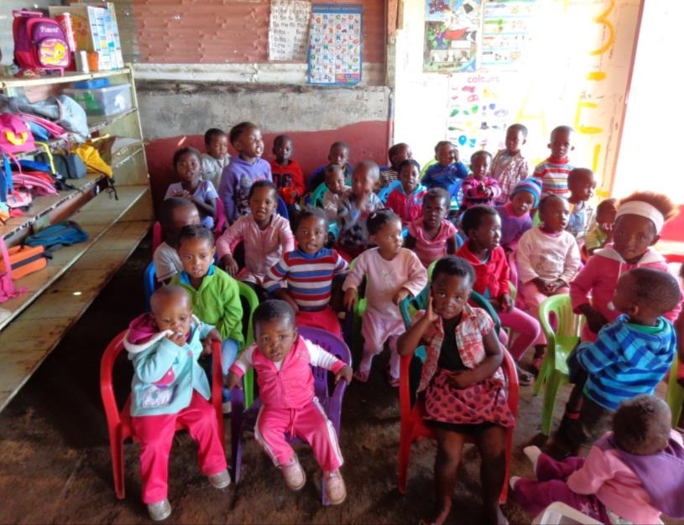
What is Early Childhood Development (ECD)?
ECD is an “umbrella term that applies to the processes by which children from birth to at least 9 years grow and thrive, physically, mentally, emotionally, spiritually, morally and socially”.
– Department of Education
White Paper 5 (2001)

Slide 6
Value of ECD
ECD is critical to the development of young children and has life-long benefits.
Benefits recognised by the National Development Plan (National Planning Commission, 2012, p. 296) include:
  Better school enrolment rates, retention and academic performance;
  Higher rates of high school completion;
  Lower levels of antisocial behaviour;
  Higher earnings;
  Better adult health and longevity.

Slide 7
Value of ECD
ECD is critical to the development of young children and has life-long benefits.
Benefits recognised by the National Development Plan (National Planning Commission, 2012, p. 296) include:
  Better school enrolment rates, retention and academic performance;
  Higher rates of high school completion;
  Lower levels of antisocial behaviour;
  Higher earnings;
  Better adult health and longevity.
Supporting ECD in informal settlements is about addressing intergenerational poverty
sometimes referred to as a ‘”cycle of poverty”
which ‘results from poor health and nutrition, deficient care, and limited stimulation which negatively affect ECD and can contribute to poor health and schooling outcomes’ (Biersteker, 2013).

Slide 8
Research Aim
To understand the challenges faced by informal ECD centres.
To establish scalable means to assist informal ECD centres to care for young children and enable them to grow and thrive.
“We sometimes assume that children in day care centres are being stimulated and prepared for school but, this is often not the case as many [ECD] centres in under-resourced communities function merely as baby-sitting facilities” – Cotlands, 2012

Slide 9
What is an “informal ECD centre”?
An informal ECD centre is a
place of care for children between the ages of 0 and 9;
that is not registered with the Department of Social Development (DSD) as a ECD centre (partial care centre);
Does not have an ECD programme that is registered with the DSD;
and is typically unable to register to register with the DSD.
What is “partial care”?
“Partial care is provided when a person ... takes care of more than six children on behalf of their parents or care-givers during specific hours” - Section 76 of the Children’s Act, No. 38 of 2005 (as amended by Act 41 of 2007)
(Various care settings are excluded – for example schools and hospitals)

Slide 10
Partial care registration
The DSD requires anyone providing partial care to:
Register their programme;
Register the facility / place where children are cared for;
Have certain qualifications and / or experience.
(Refer to the “Consolidated regulations pertaining the Children’s Act, 2005”, DSD, 2010)
And any ECD centre seeking DSD subsidies (and other support)
Must be a registered a non-profit organisation (NPO).

Slide 11
Inability to Register & Access Support
There are material barriers to most informal ECD centres registering with the DSD and accessing grants and other support because they are unable to meet the 3 main requirements of the DSD:
Inability to register as partial care facilities: They are unable to meet the minimum norms and standards and requirements for registration ‘partial care facility’ due to
    zoning, infrastructure and tenure issues.
Inability to register partial care programmes: they face difficulties in being able to meet the minimum norms, standards and requirements pertaining to ECD programmes.
They are typically not registered as NPOs: most would be unable to fulfil and sustain the operational requirements (e.g. pertaining to corporate governance) unless they receive support.
  and therefore can’t access benefits such as DSD training or raise donor funding.

Slide 12
Implications of Non-Registration
Barriers to accessing grants & increasing state funding for ECD.
Cannot access additional operating funding which has the potential enable informal ECD centres to make improvements.
Children from the most vulnerable households are precluded from attending either formal or informal ECD centres as informal ECD centres charge fees and very few formal ECD centres (i.e. partial care facilities), whose attendance the DSD would subsidise, exist in or near informal settlements.

Slide 13
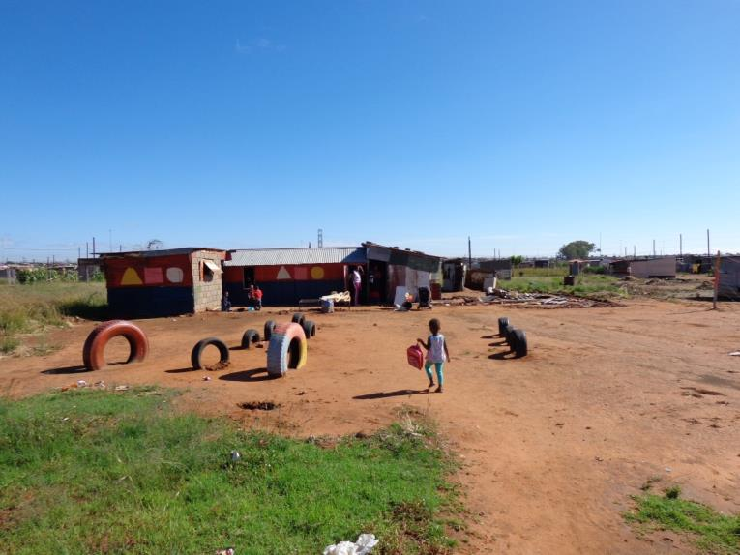
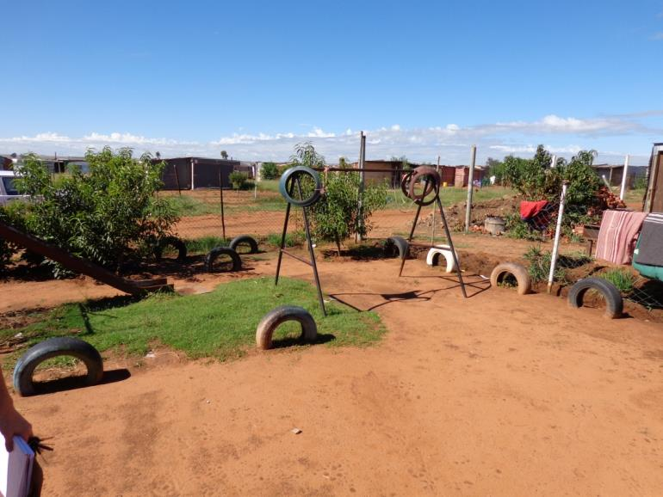
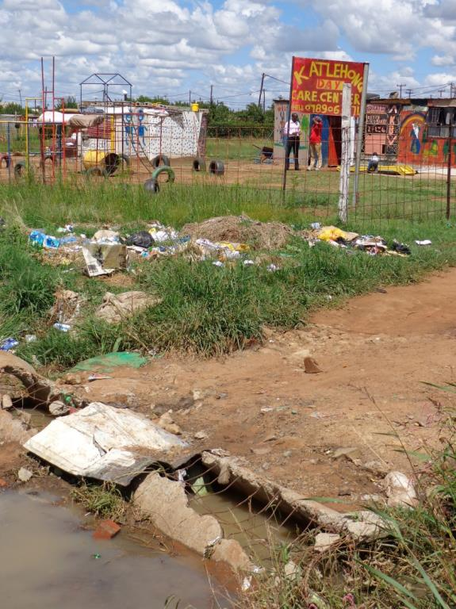
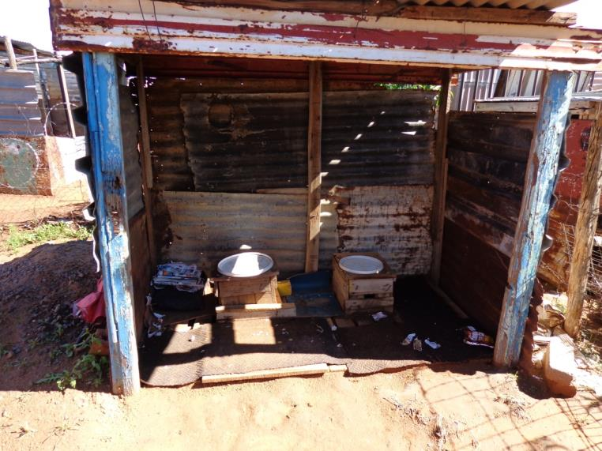
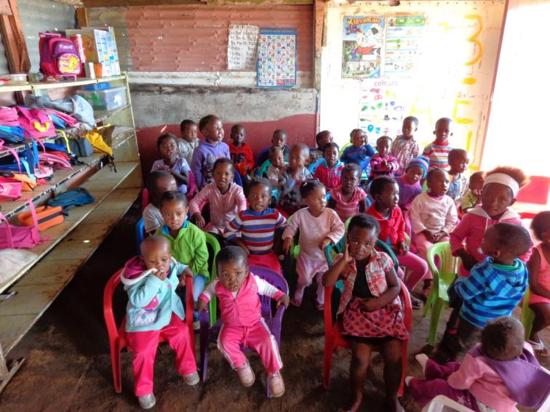
Informal ECD centres face significant challenges
Lack basic play equipment and resources (e.g. jungle gyms, learning materials, tables, chairs and educational toys)
Inadequate facilities
& infrastructure
Overcrowded
Lack basic services such as
refuse removal

Slide 14
Informal ECD centres face significant challenges
Lack of skills and capacity (especially pertaining to care, education and institutional management);
Lack access to training;
Unable to retain trained and skilled ECD personnel;
Inadequate access to financial support (e.g. operational subsidies and other grant funding);
Inadequate access to state nutritional support programmes;
Limited or no monitoring and support which is key to improving their quality.
Lack basic services such as
refuse removal

Slide 15
Informal ECD centres face significant challenges
There is effectively no relationship between informal ECD centres and government and no structured programmes to support and assist informal ECD centres which fail to meet minimum requirements.
‘The current system of provision is blind to the majority of young children who are outside the system. It only 'sees' the children who are in registered ECD facilities.’
– David Harrison (2012)
Lack basic services such as
refuse removal

Slide 16
Informal ECD centres face significant challenges
“Crèches that cannot meet requirements for DSD registration as ‘Places of Care’ are overlooked by government and in many cases these crèches are the ones that provide a much needed service to the children and communities in which they are situated”
Ekukhanyeni Relief Centre, 2012
Lack basic services such as
refuse removal

Slide 17
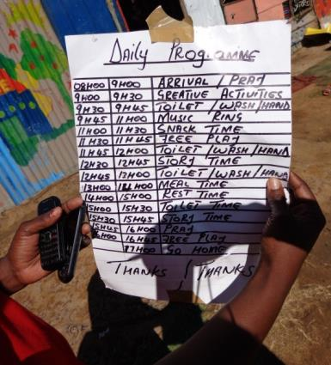
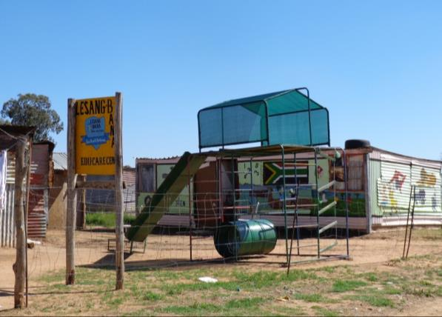
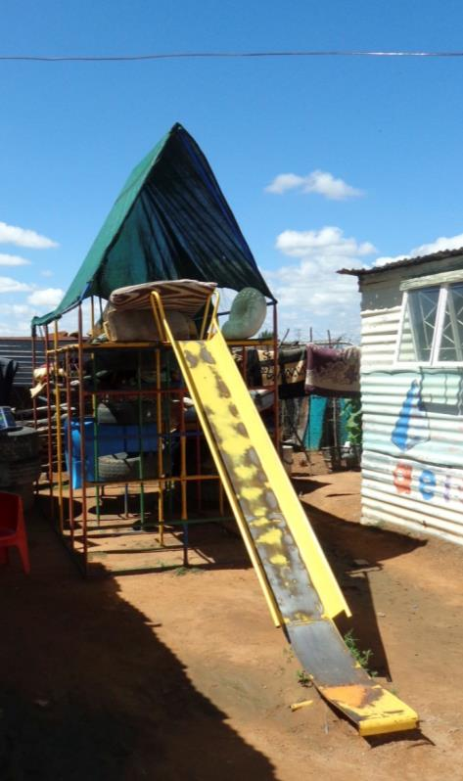
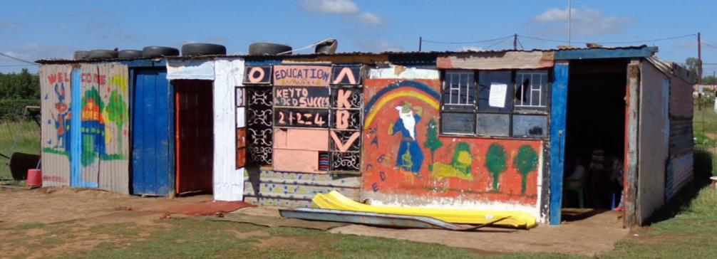
The positives
Most informal ECD centres are interested and motivated to make improvements and improve the care and early childhood development programmes which they provide but lack the necessary capacity, information, relationships and resources.

Slide 18
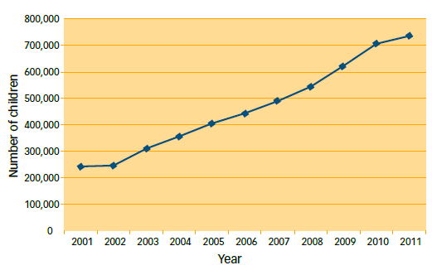
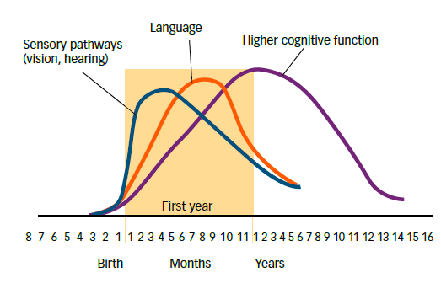
ECD is an increasing priority for government
DSD subsidies for ECD centres has increased from less that R335 million in 2003/2004 to more than a billion rand in 2011/2012 (Giese et al, 2011).
Grade R Enrolment
(Source of graphs Berry, L., Biersteker, L., Dawes, A., Lake, L. & Smith, C. (eds.). 2013. South African Child Gauge 2013. Children’s Institute, University of Cape Town. Pages 66 & 72.)

Slide 19
ECD is an increasing priority for government
DSD subsidies for ECD centres which has increased from less that R335 million in 2003/2004 to more than a billion rand in 2011/2012.
Grade R Enrolment
“The platform for successful education needs to be built bottom up. To use an analogy, you can’t build a tower from children’s building blocks by starting in the middle. The building blocks need to be stacked up from the floor. Yet, for most children, we start trying to lay down the building blocks from the middle – when they enter Grade R.”
- David Harrison, 2012
(Source of graphs Berry, L., Biersteker, L., Dawes, A., Lake, L. & Smith, C. (eds.). 2013. South African Child Gauge 2013. Children’s Institute, University of Cape Town. Pages 66 & 72.)

Slide 20
The significant need to expand access to quality ECD
Approximately 3.8million children (59%) live in dire poverty in South Africa (Atmore, et al. 2012).
There are approximately 1.76 million children living in informal dwellings and 3.06 million living in traditional dwellings (Hall, 2013).
‘Only a third of young children are exposed to registered child care or education outside of the home. Among the poorest 40% of our population, the proportion drops to one fifth’ (Harrison, 2012).
Grade R Enrolment

Slide 21
The significant need to expand access to quality ECD
Approximately 3.8million children (59%) live in dire poverty in South Africa (Atmore, et al. 2012).
There are approximately 1.76 million children living in informal dwellings and 3.06 million living in traditional dwellings (Hall, 2013).
Less than 1/5th of the poor (40% of the population) have formal ECD access (Harrison, 2012b).
Informal ECD is an extremely important issue and addressing it is central to SA overcoming broader developmental challenges,
and there is no other readily available alternative (at least in the short to medium term).

Slide 22
Additional Key Findings
Informal ECD centres represent significant livelihoods opportunities for the operators and staff who work at the centres.
NPO registration can be beneficial but only provided the organization has sufficient capacity and ability to sustain compliance.
There is a tendency for ECD centres to be easily established and to rapidly proliferate in response to an obviously large and unmet demand for affordable child care amongst the urban poor.
There are relatively high numbers of informal ECD centres.
This could pose a resource challenge for the DSD in responding unless there is a clearly prioritized basis upon which engagement and incremental support is offered.

Slide 23
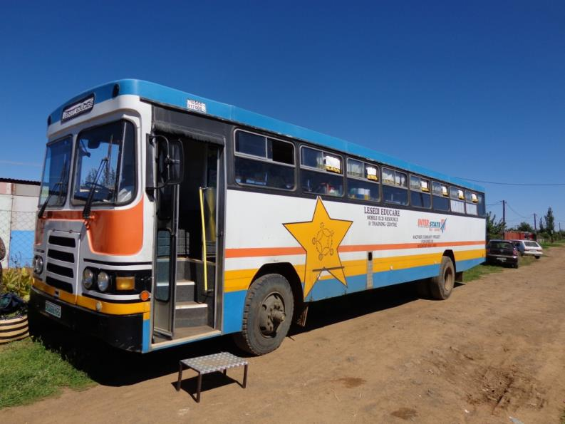
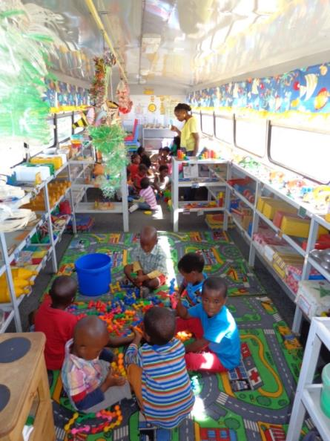
Current responses addressing programme & facility challenges include
Mobile ECD centres
Advantages
They are well resourced
Have skilled staff
Are mobile and can reach impoverished areas (including informal settlements
Disadvantages
They are expensive
Can only reach a few sites in a week or month

Slide 24
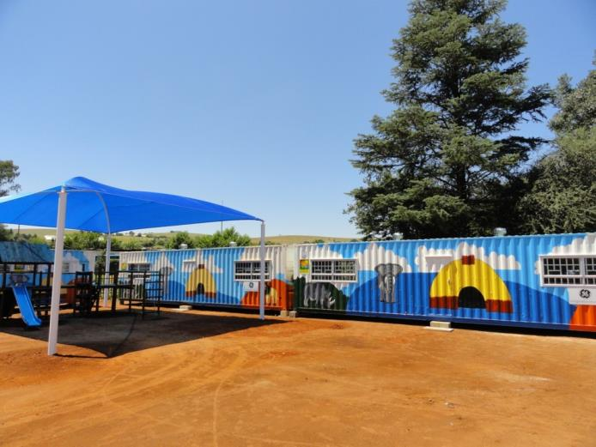
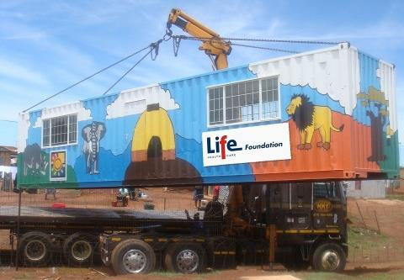
Semi-permanent structures & other infrastructure
Advantages
They are well equipped
Popular with CSI
Often linked to training & ongoing support
Disadvantages
They are expensive
Can’t be rolled out rapidly & meet the scale of the challenge

Slide 25
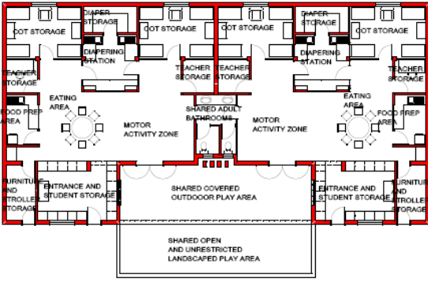
Construction of formal buildings outside informal settlements
Advantages
They are well equipped
High quality and will meet all norms & standards
Disadvantages
They are very expensive
Can’t be rolled out rapidly & meet the scale of the challenge
Unlikely to be built in informal settlements
Unlikely to be accessible to children from informal settlements

Slide 26


Current responses can’t meet the scale of the challenge
The state should adopt a new approach
  Which is
  Incremental,
  Systematic,
  Inclusive,
  And is not reliant on formal registrations
  (i.e. partial care facility & partial care programme registration, and NPO registration).

Slide 27
The Aim of the New Approach
To rapidly achieve improvements in
health,
safety,
and care (including improved ECD programmes)
for large numbers of vulnerable children.

Slide 28
The New Approach
Willingness to work with informal ECD centres
DSD & state support should not be contingent on NPO or partial care registration
1) Identify & ‘map’ informal ECD centres &
2) rapidly assess and categorise them
Provide support
Criteria:
Institutional Capacity,
Care
Learning / Child Development
Infrastructure
Varying levels of support should be provided depending on categorisation
according to transparent & clearly defined criteria.
Recognise that many are able to provide ‘acceptable informal ECD services’ even though they might not be able to achieve formal registration standards
Recognise the value and importance of informal ECD centres.

Slide 29
Rapid Assessment & Categorisation (RAC)
ECD centres should be divided into 3 main categories (with sub- categories) and should qualify for various forms of support (or not) accordingly.
Key assessment and categorisation considerations are:
The potential to function as an ‘acceptable informal ECD centre’.
The extent of health and safety threats and whether or not these can be mitigated.
The experience, intent and commitment of the operator (including to work with the DSD and other stakeholders in making improvements).
The potential for formalisation (but only for categories A and B1 which will only constitute a relatively small proportion of all ECD centres).

Slide 30
“Acceptable informal ECD centres”
(Working definition)
Provide a minimum level of physical care to children (e.g. not excessively overcrowded, sufficiently dry and ventilated, nutrition is adequate if not ideal).
Where a basic level of learning, stimulation and child development is evident.
Owner is committed and has the right intentions evidenced by actions taken and investments already made in their informal ECD.
Centre owner and management are committed and able to incrementally improve the ECD services they provide.
The centre either have no material health and safety threats OR these threats can be rapidly mitigated (e.g. by emergency investments in infrastructure such as improved water and sanitation).

Slide 31
The Categories
Category A: High potential ECD centres.
Category B: Moderate potential providing acceptable informal ECD services or with good potential to reach this level.
Category C: Non-acceptable ECD centres.

Slide 32
The Categories
Category A: High potential ECD centres
(i.e. fully or conditionally registered partial care facilities or with the potential to achieve this level rapidly).
Category B: Moderate potential providing acceptable informal ECD services or with good potential to reach this level
(i.e. the level of a non-registered ECD centre which is nonetheless recognised to provide a minimum level of acceptable basic care to children and is intent on improving their services).
Category C: Non-acceptable ECD centres.
Some of these will nonetheless warrant emergency investments to mitigate material health and safety threats in cases where there are not yet alternative ECD facilities available for children at risk.

Slide 33
The Categories
Category A
Category B1
Category B2
Category C1
Category C2
Category C3

Slide 34
Responses & Support
Category A
Response
Support & Action

Slide 35
Category A: High Potential
Category A: High potential ECD centres (i.e. fully or conditionally registered partial care facilities or with the potential to achieve this level rapidly).
Includes ECD centres that can (or already do) meet formal registration requirements.
There are very few such centres.

Slide 36
Category A
High potential ECD centres
Response
Significant levels of support & investment
Incremental & ongoing support
Long term
Support & Action
Advanced training (e.g. by NGOs or FET colleges)
Board training & mentorship
Assist with nutrition
Provide or assist with acquiring resources
Major ECD centre infrastructure improvements. Movement to new site if this will enable partial care registration.
Assist with partial care facility registration application including assistance with engagement with the LM

Slide 37
Category B: Moderate Potential
B1: Basic-functioning and providing acceptable informal ECD services and with moderate potential for registration.
B2: Basic or low-functioning with good potential to be a functional informal ECD centre rendering acceptable informal ECD services (or have already attained this level) but with limited potential for registration.

Slide 38
Category B1
Basic-functioning and providing acceptable informal ECD services and with moderate potential for registration
Absence of material health and safety threats (or easily mitigated).
Significant potential for improvement.
Response
Significant levels of support & investment warranted
Provide incremental & ongoing support
Long term
Support & Action
Formal and / or informal training (e.g. by NGOs or at FET colleges) and informal training
Assist with NPO registration (incl. board selection & training and mentoring, training on functions NPOs)
Assist with nutrition
Provide or assist with acquiring educational resources
ECD centre improvements (e.g. improved sanitation, minor structural improvements, fencing)

Slide 39
Category B2
Low-functioning but with good potential to render acceptable informal ECD services.
Absence of material health and safety threats (or easily mitigated).
Significant potential for improvement.
Response
Significant levels of support and investment warranted
Provide incremental & ongoing support.
Long term
Support & Action
Basic training
Assistance with nutrition
Provide or assist with acquiring educational resources
Minor ECD centre improvements (e.g. improved sanitation, fencing, minor improvements to structure)

Slide 40
Category C: Non-acceptable
C1: Low-functioning with limited or no prospects for rendering acceptable informal ECD services but with no material health and safety threats and no other alternatives for children in care.
C2: Low-functioning with limited or no prospects for rendering acceptable informal ECD services but with significant health and safety threats which can and should be rapidly mitigated through emergency assistance / investments (e.g. sanitation, water supply, fencing, nutrition etc.).
C3: Low-functioning with limited or no prospects for rendering acceptable informal ECD services and with significant health and safety threats which cannot be rapidly mitigated through emergency assistance / investments (e.g. sanitation, fencing etc.).

Slide 41
Category C1
Low-functioning with limited or no prospects for rendering acceptable informal ECD services but with no material health and safety threats. No alternative for children in care.
Response
No immediate actions other than on-going monitoring.
In the long term closure would be ideal once alternative care exists.
Support & Action
None, only monitoring to take place

Slide 42
Category C2
Low-functioning with limited or no prospects for rendering acceptable informal ECD services with significant health & safety threats which can be rapidly mitigated through emergency assistance. No alternative for children in care.
Response
In the short term - emergency support to mitigate risk of harm.
In the long term closure (when alternative care exists.)
Support & Action
Minor emergency improvements (e.g. improved sanitation, improved safety of ECD centre structure, fencing)
Identify local formal and informal ECD alternatives

Slide 43
Category C3
Low-functioning with limited or no prospects for rendering acceptable informal ECD services and with significant health and safety threats which cannot be rapidly mitigated through emergency assistance
Response
Only as a last resort and in extreme cases: Centre should be closed down even if there are currently no other alternatives for children in care.
Support & Action
Close ECD centre.
Identify local formal and informal ECD alternatives.

Slide 44
Varying Levels of Support
Programme support: e.g. training, mentorship, subsidisation (including inclusion in feeding schemes)
Infrastructure and resource support

Slide 45

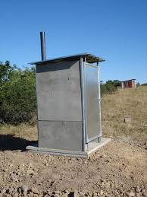




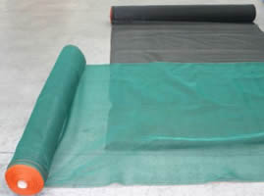
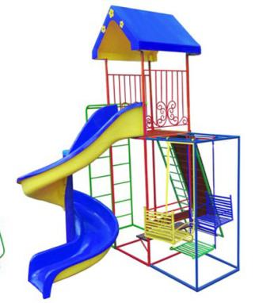
Infrastructure

Slide 46
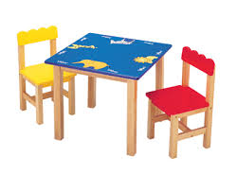




Resource Support
Requirement: financial contribution (X % of cost)
Linked to training

Slide 47
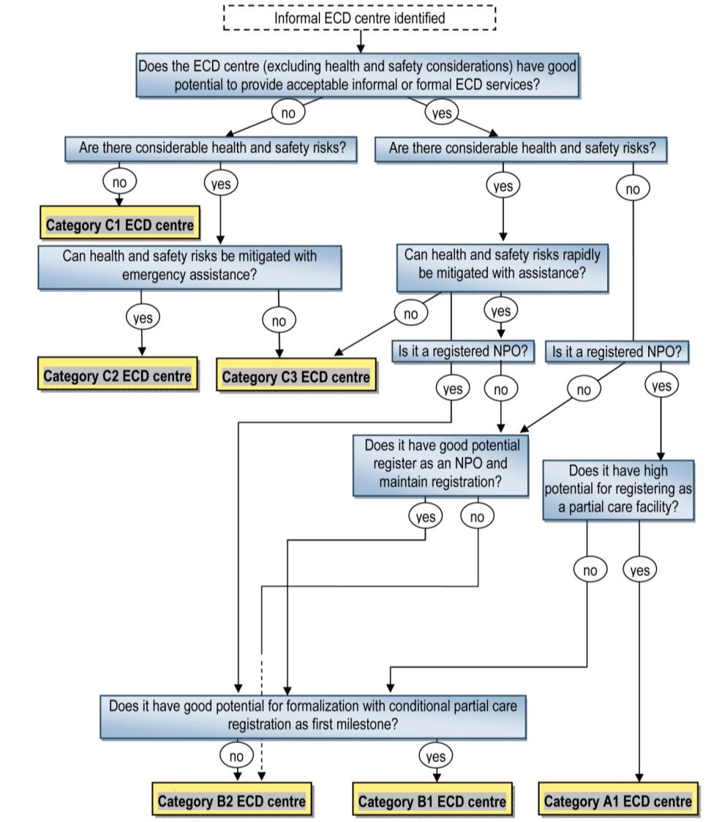

Slide 48
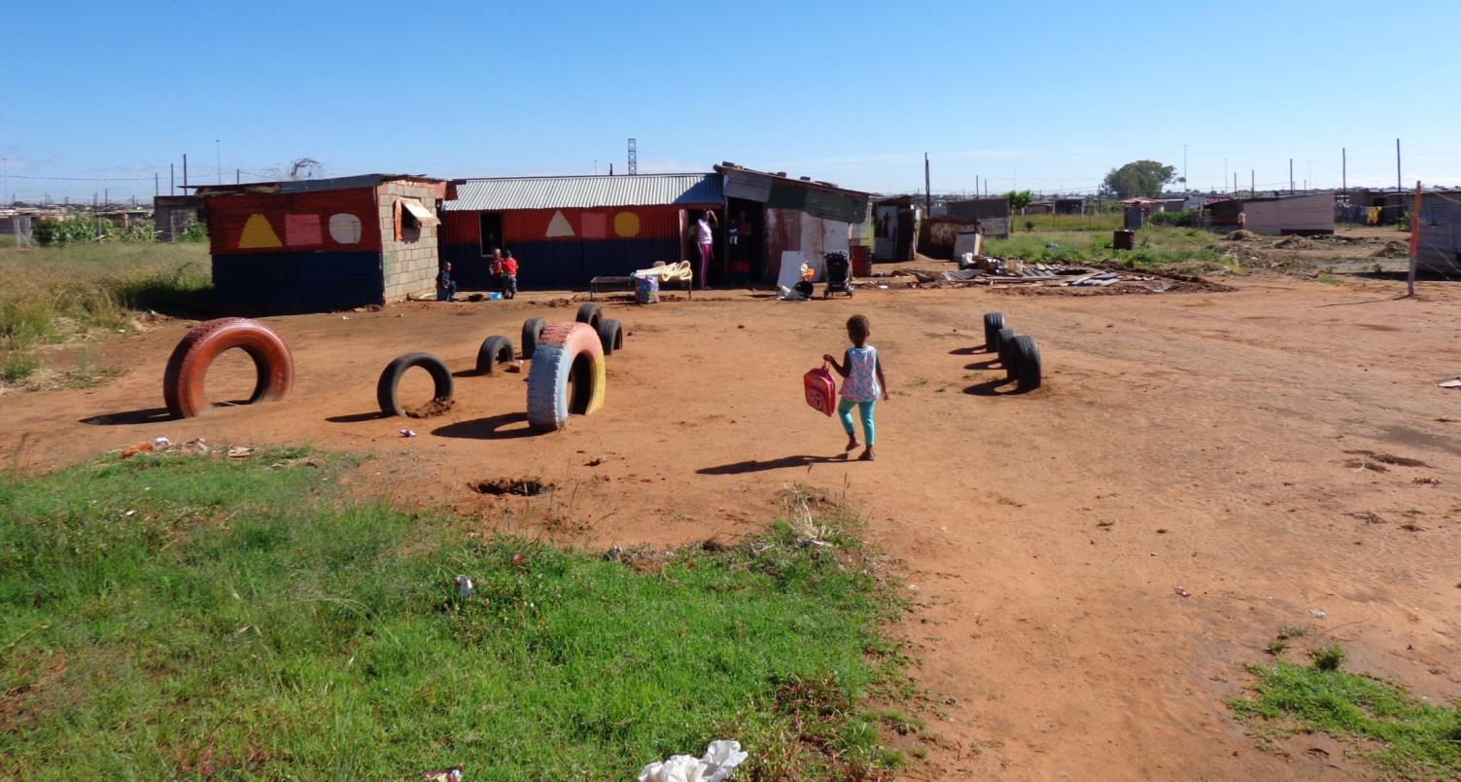

Slide 49
Kamohele Crèche (Kamohele) was established in 2009
One woman is employed to look after the children. The owner-operator has a second crèche. She has no formal training.
Parents pay fees of between R120 and R150 per month for the children’s attendance.
The informal ECD centre is not registered as a partial care facility or NPO and has reportedly not been visited by the DSD, Municipality or any other Department.
Kamohele has been provided with material support by the local Christian Revival Church and parents that provided paint and corrugated iron sheeting. It receives mentorship support from Ke Na Le Matla (CBO).

Slide 50
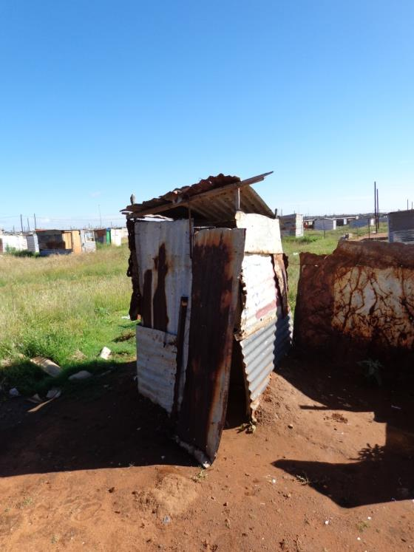
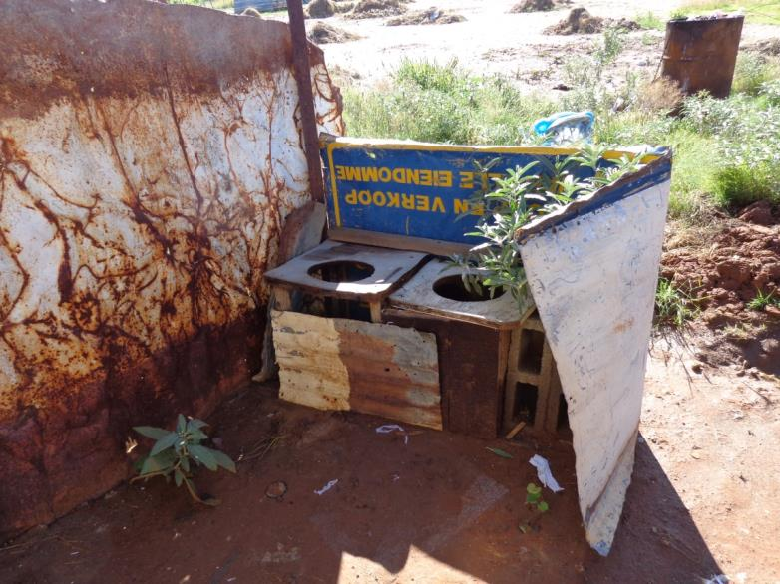

Slide 51
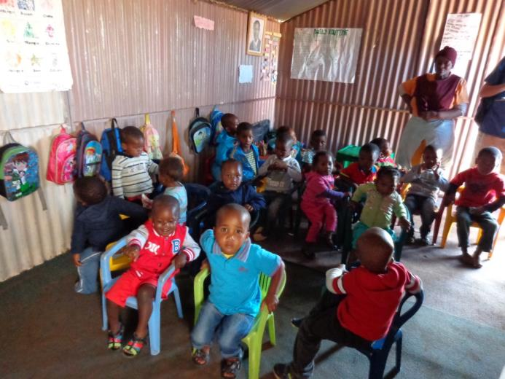
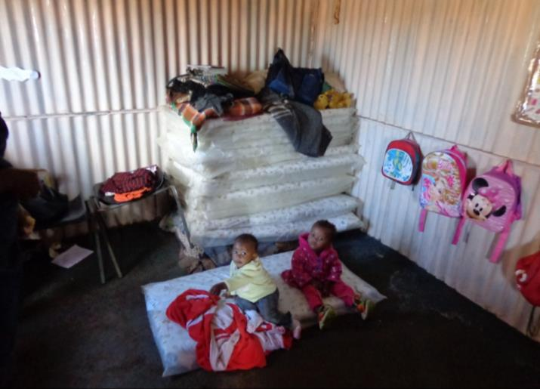

Slide 52


Slide 53
Category B2
Low-functioning but with good potential to render acceptable informal ECD services.
Absence of material health and safety threats (or easily mitigated).
Significant potential for improvement
Response
Significant levels of support and investment warranted
Provide incremental & ongoing support.
Long term
Support & Action
Basic training
Assistance with nutrition
Provide or assist with acquiring educational resources
Minor ECD centre improvements (e.g. improved sanitation, fencing, minor improvements to structure)

Slide 54
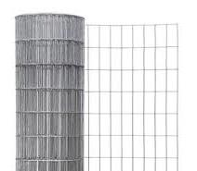


Infrastructure & Resource Support

Slide 55
Implementing
Rapid Assessment & Categorisation (RAC) theoretical example – for illustration purposes

Slide 56
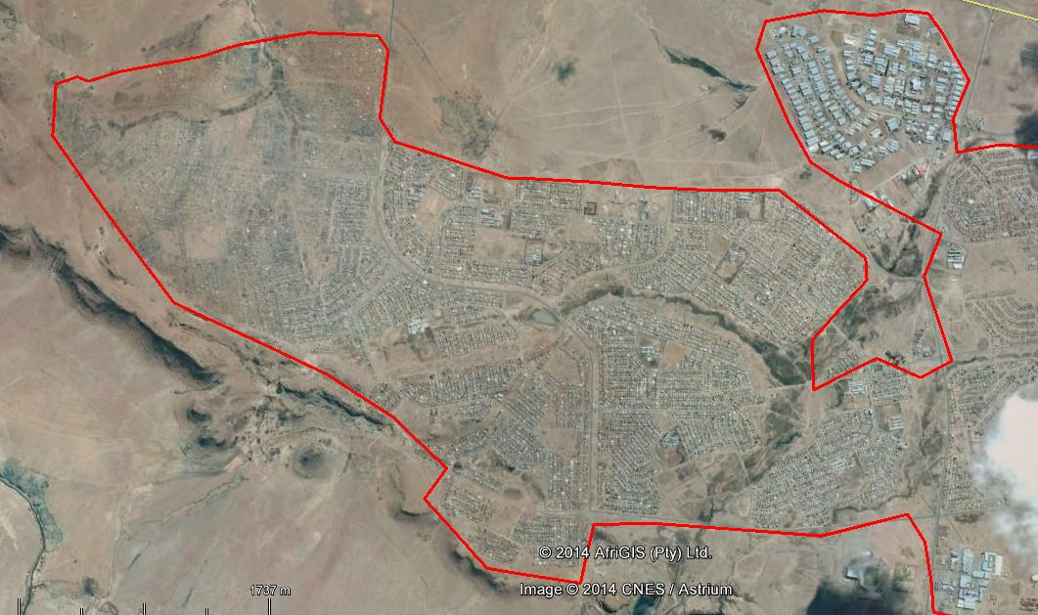

Mangaung Municipality IDP
includes a R1.4 million ECD centre

Slide 57
Example of expenditure using RAC method
C2
C2
B1
B2
B1
C1
C2
B2
A
C2
B2
B2
B1
C1
A
C3

Slide 58
Theoretical example of expenditure using RAC method
C2
No. centres
C2
Cost
B1
B2
B1
A | 2 | R 400k
B1 | 2 | R 170k
B2 | 20 | R 800k
C2 | 2 | R30k
TOTAL | 26 | R 1.4 million
C1
C2
B2
A
C2
B2
B2
B1
C1
A
C3

Slide 59
State funding & Role Players
Infrastructure
MIG (Municipal Infrastructure Grant)
USDG (Urban Settlement Development Grant) intended principally for informal settlement upgrading available mainly to Metros and certain high-capacity Municipalities.
DHS (Department of Human Settlements)
Operational Funding & Other Assistance)
DSD subsidy& programme funding
DBE (Department of Basic Education)
EPWP (Expanded Public Works Programme)
  CWP (Community Works Programme)
NDA (National Development Agency)
LM (Registration Assistance & Grants in aid)

Slide 60
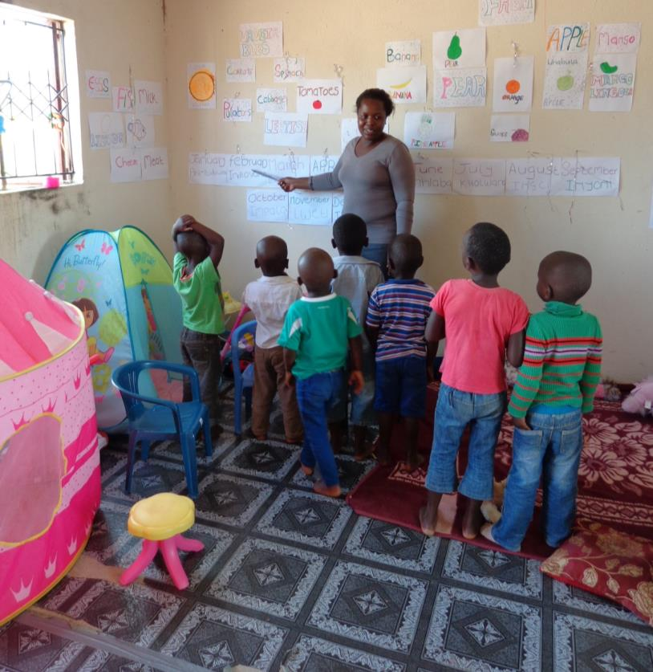
Finally…
“The single most important investment a country can make is in its people”
– National Development Plan, 2012
Investing in informal ECD is about putting the fundamentals in place to break cycles of intergenerational poverty and is a highly strategic investment.

Slide 61
Reference List
Biersteker, L., 2013. “Getting the basics right: An essential package of services and support for ECD”. Berry, L., Biersteker, L., Dawes, A., Lake, L. & Smith, C. (eds), 2013. South African Child Gauge 2013. University of Cape Town and the Children’s Institute. Cape Town: University of Cape Town.
Berry, L., Biersteker, L., Dawes, A., Lake, L. & Smith, C. (eds.). 2013. South African Child Gauge 2013. Children’s Institute, University of Cape Town.
Cotlands, 2013. Poor literacy at school stems from lack of early stimulation. Available at: http://www.dgmtcommunity.co.za/sites/dgmt/files/documents/Cotlands_PoorLiteracyatSchool.pdf
Ekukhanyeni Relief Project, 2012. “How to develop a crèche in a poor and marginalized area”. The DG Murray Trust, Hands-on: Learning from our implementing partners, Edition 6 (September – December 2012). Available at: http://www.dgmt.co.za/files/2013/01/LearningBrief-32-web-final.pdf
Giese, S., Budlender, D., Berry, L., Motlatla, S., & Zide, H. 2011. Government funding for early childhood development: Can those who need it get it?. Research report commissioned by Ilifa Labantwana, Cape Town.
Harrison, D. 2012. “The state of early childhood development in South Africa”. Strategies to Overcome Poverty and Inequality: Towards Carnegie III. 3 – 7 September 2012, Cape Town, South Africa. Cape Town: University of Cape Town. .
National Planning Commission, 2012. “National Development Plan 2030: Our future – make it work”. Pretoria: Government Printing Works.
Richter, L., Biersteker, L., Burns, J., Desmond, C., Feza, N., Harrison, D., Martin, P., Saloojee, H. & Slemming, W. 2012. Diagnostic Review of Early Childhood Development. Pretoria: Department of Performance, Monitoring and Evaluation & Inter-Departmental Steering Committee on ECD.

